Slide 1

Data Science Rookies Group Project 1
Sunroof Project Analysis
Team #4
Bradley Reardon, Pranay Bhakthula, Baldur Hua, Jichong Wu, Qinyuan Xing

Slide 2
Outline
Data Set Overview
Exploratory Data Analysis
Model Building
Conclusions

Slide 3
Data Set Overview

Slide 4
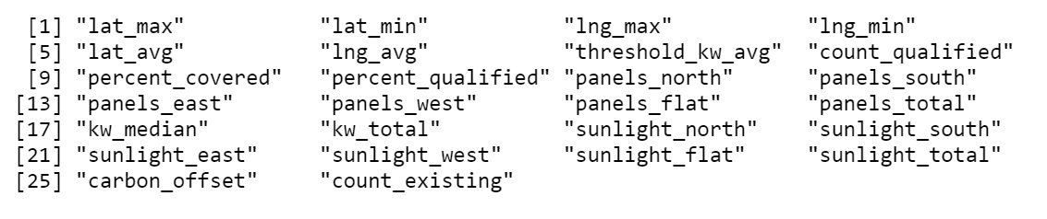
Data Set Overview
The dataset, compiled by the Google Project Sunroof, contains the estimated number of solar panels, amount of solar energy generated, and carbon dioxide abatement in cities throughout the United States.
Dataset Source: Kaggle
7,899 observations and 26 variables (After rearrangement)

Slide 5
S.M.A.R.T Questions
Analyze: Which variables have the greatest effect on the total solar energy generation potential?
Determine: Which variables significantly effect the estimated carbon dioxide abatement?
Compare: How does the estimated mean solar energy generation per panel type vary by region.

Slide 6
Exploratory Data Analysis

Slide 7
Exploratory Data Analysis Overview
Data aggregates overview
Calculating additional independent variables
Variable relationship check to prepare for building models

Slide 8
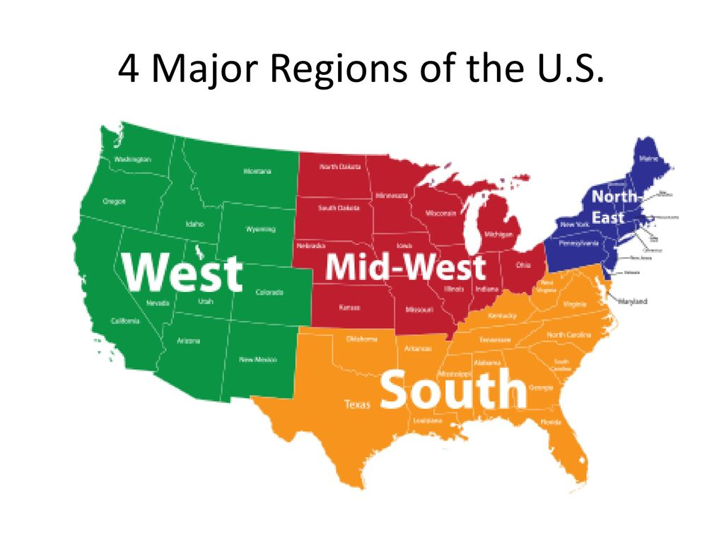
To Prepare for EDA:
Dropped 3 variables: median number of panels, median yearly sunlight (used mean values instead), install size (irrelevant to our analysis)
Shortened/renamed column titles for readability
Changed data types for numerical columns from string to numeric.
Excluded the NA values.
Created the region column as factor data for comparison analysis
Four levels: Northeast, South, Midwest, West

Slide 9
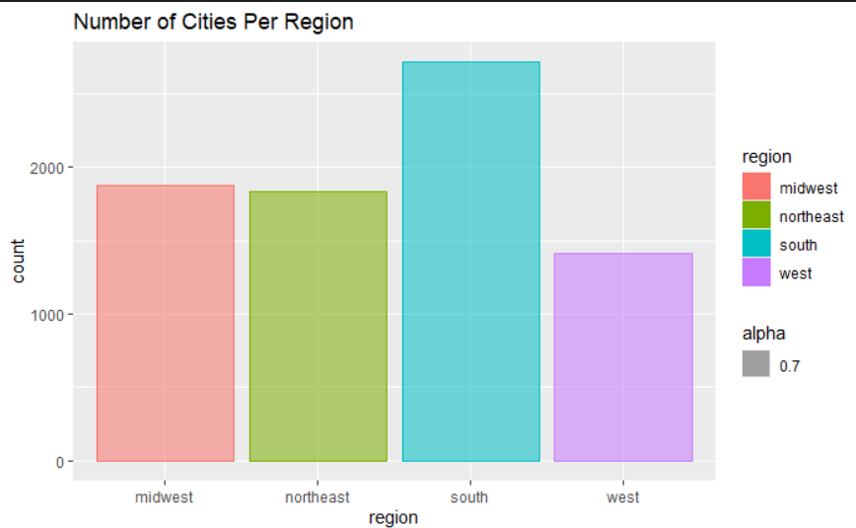
Total # of Cities by Region – Chart1

Slide 10
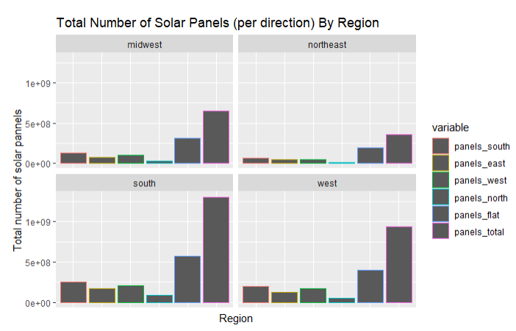
Chart 2 Total number of solar panels with direction breakdowns by region

Slide 11
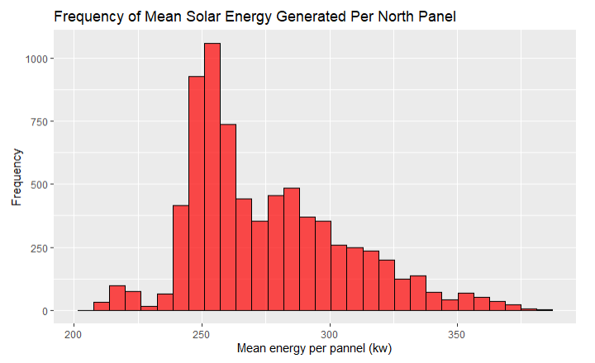
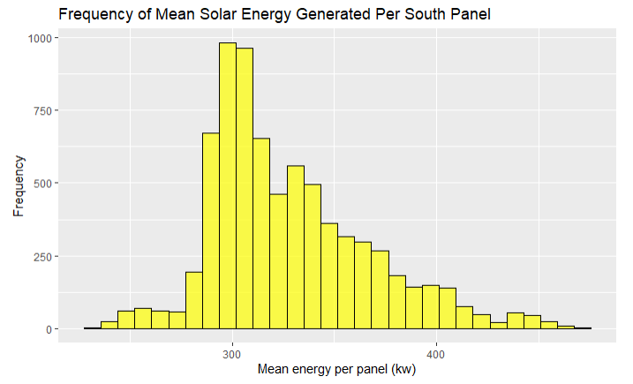
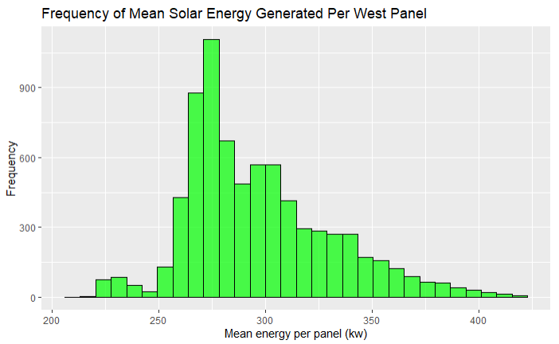
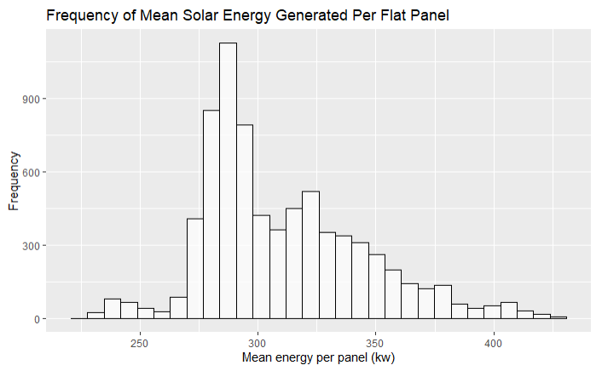
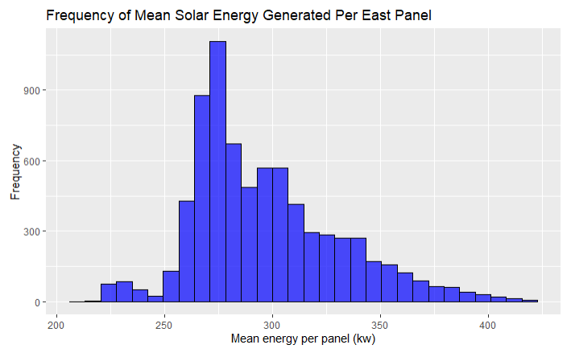
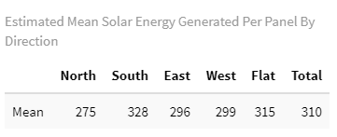
Mean Solar Energy Potential Generated Per Panel By Direction – Charts 4-8

Slide 12
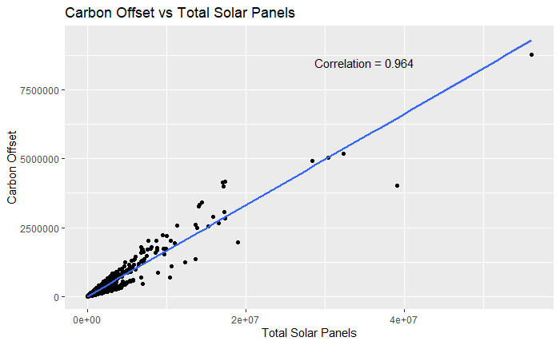
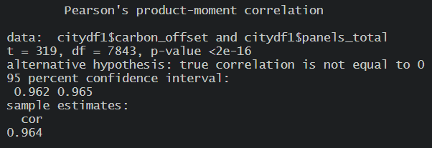
Does Total # of Solar Panel Have a Relationship with Carbon Offset Potential?

Slide 13
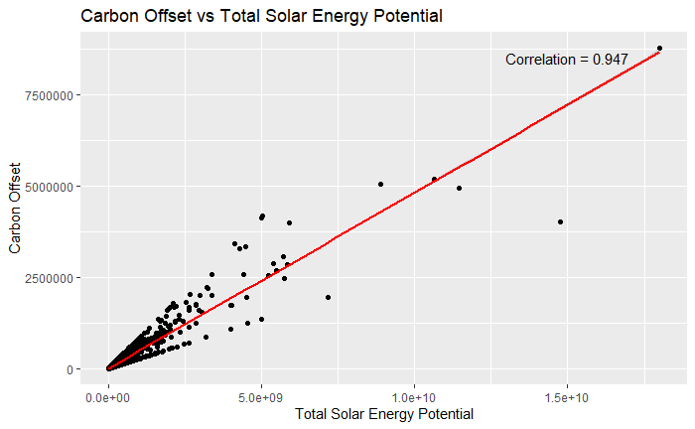
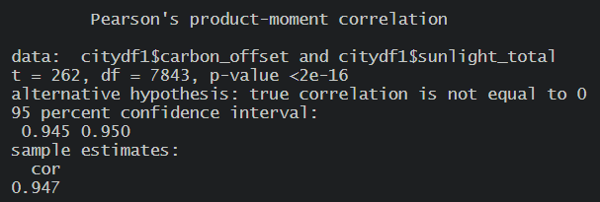
Does Total Solar Energy Potential have a relationship with Carbon Offset Potential?

Slide 14
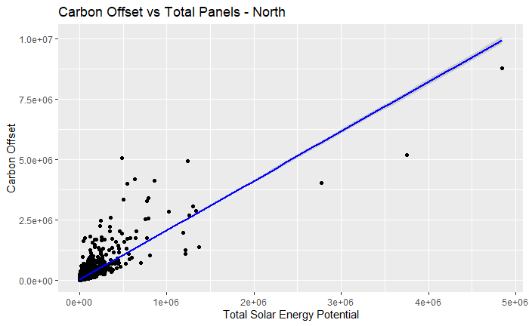
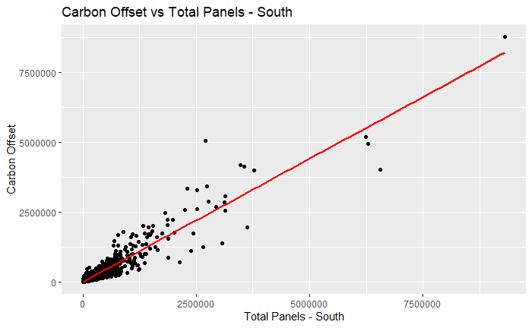
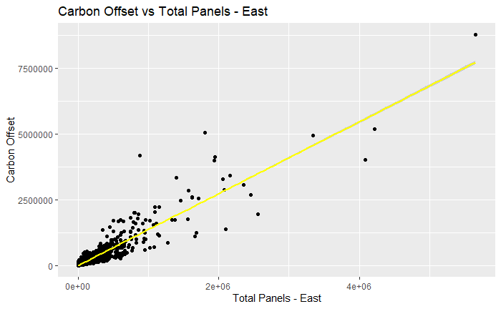
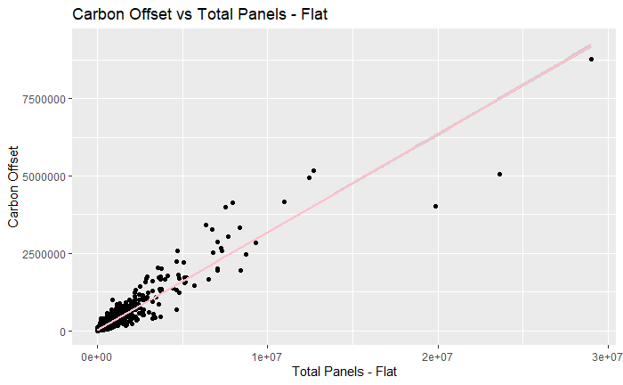
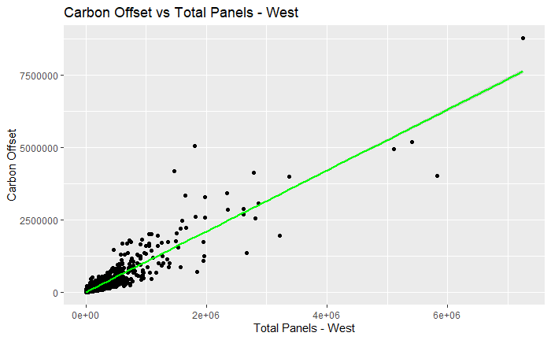
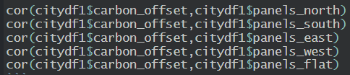
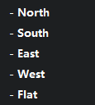
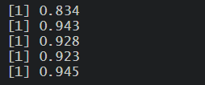
Does Solar Panel Direction Has a Relationship with Carbon Offset?

Slide 15
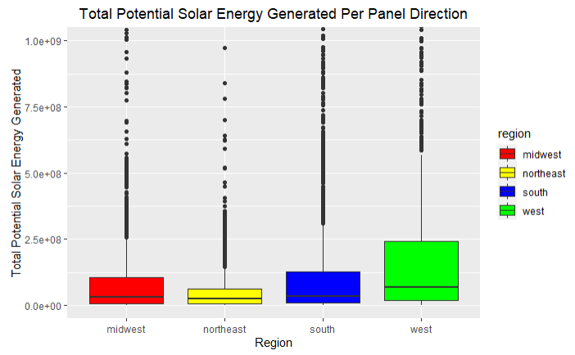
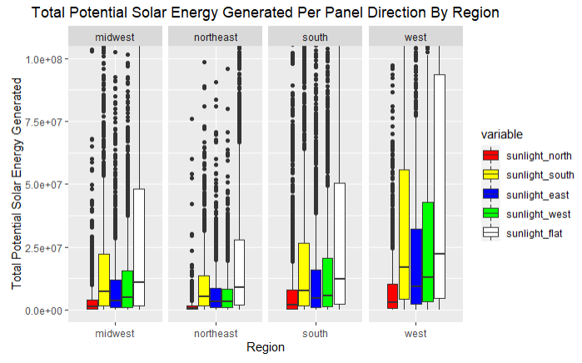
Does Location Have a Relationship with Carbon Offset?
Total solar energy production potential by region

Slide 16
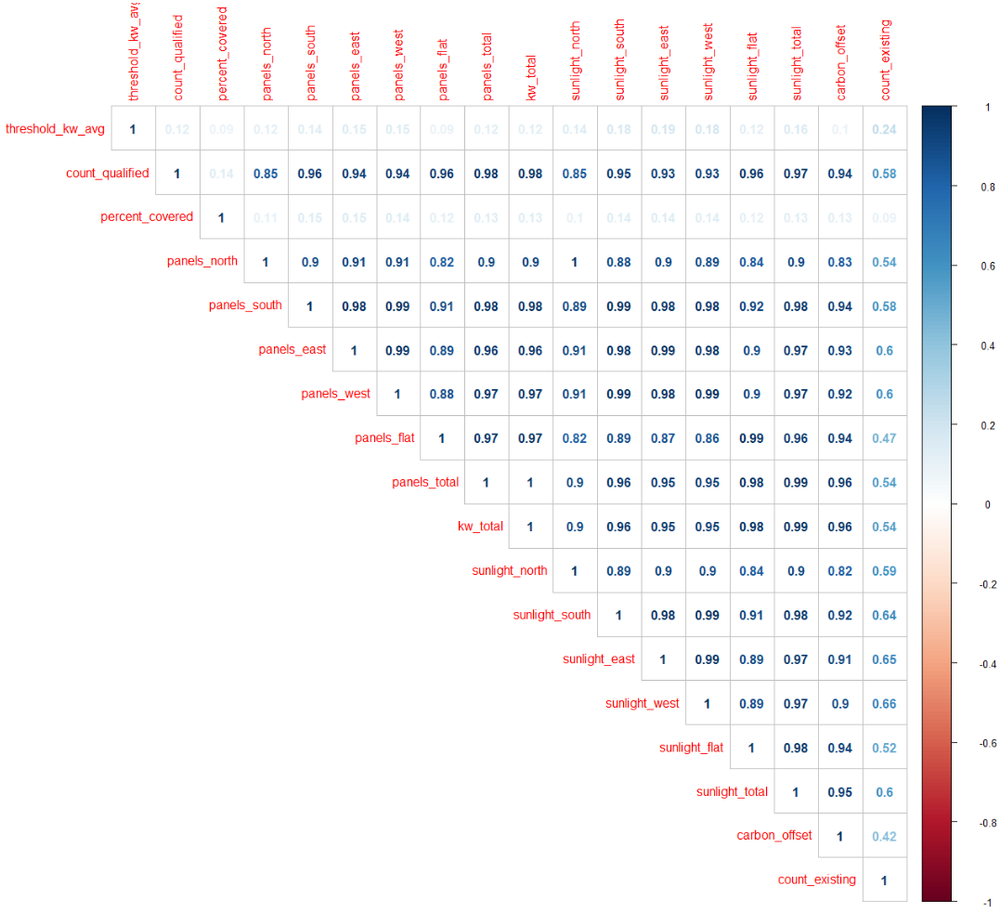
Heatmap For Correlation Checking

Slide 17
Model Building

Slide 18
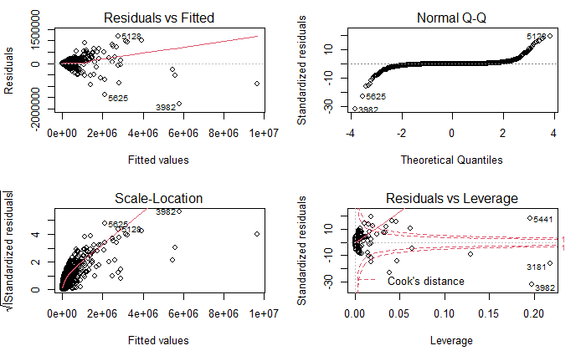
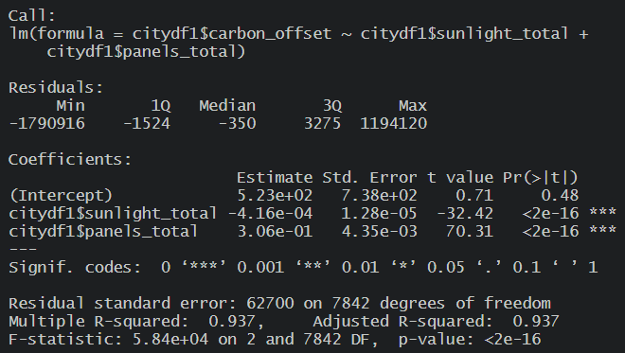
Model 1 (carbon offset ~ total solar energy potential + total # of solar panel)

Slide 19
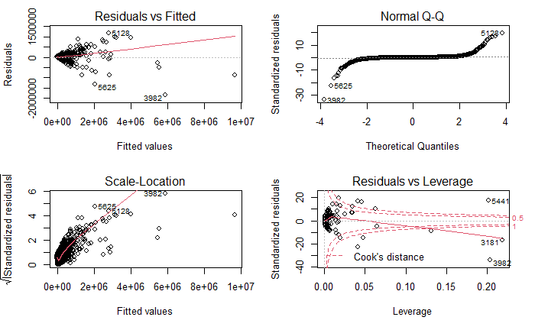
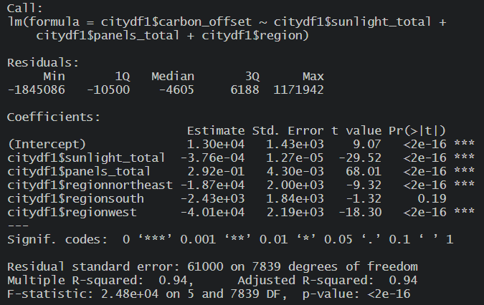
Model2 (carbon offset ~ total solar energy potential + total # of solar panels + regions)

Slide 20
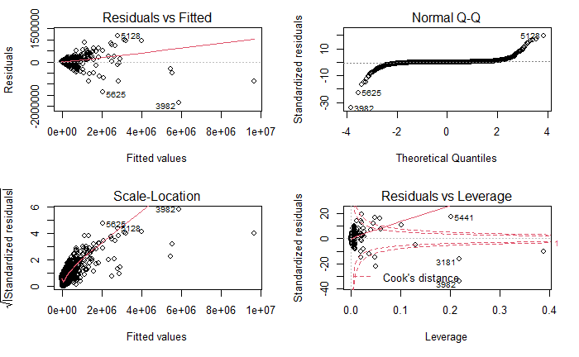
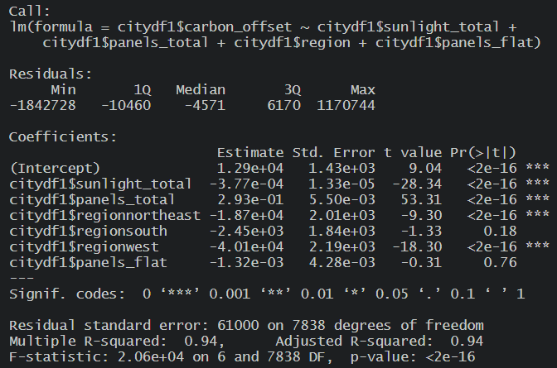
Model3 (carbon offset ~ total solar energy potential + total # of solar panels + regions + all flat panels

Slide 21
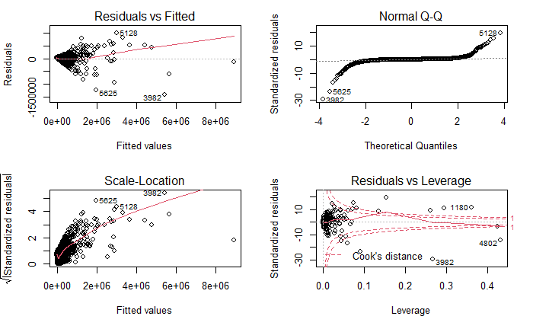
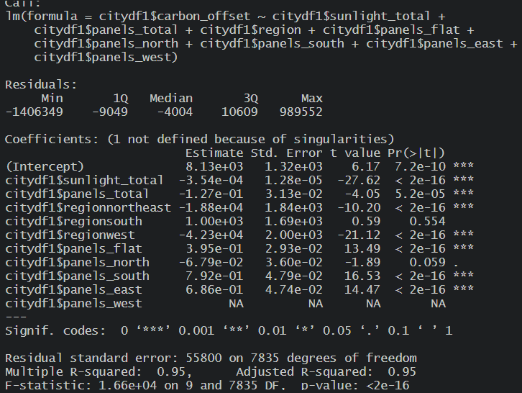
Model4 (carbon offset ~ total solar energy potential + total # of solar panels + regions + all flat panels

Slide 22
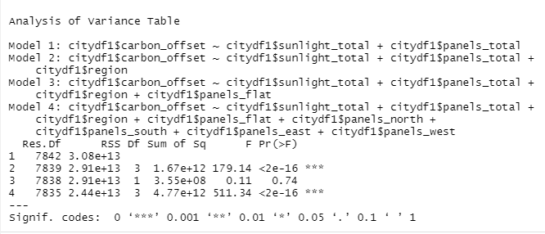
ANOVA Test On Our Four Models
Adding only the flat_panels variable in model 3 proves to be insignificant.
Model 4 shows an overall model significance after adding all panel type variables.

Slide 23
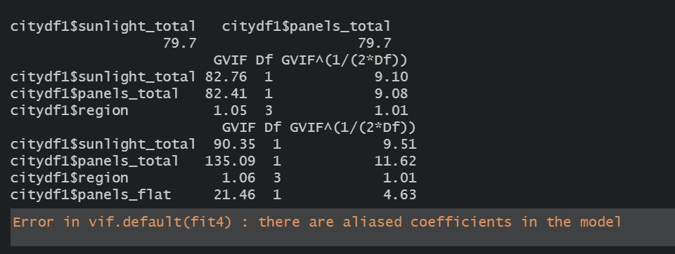
VIF Tests
From the vif tests on the models we can observe that only region variable has acceptable vif values, rest all the variables have high multicollinearity.
The vif test for model4 indicates presence of aliased coefficients in the model which means that the addition of remaining 4 directional panels to the model is resulting in perfect multicollinearity, which is not acceptable at all.

Slide 24
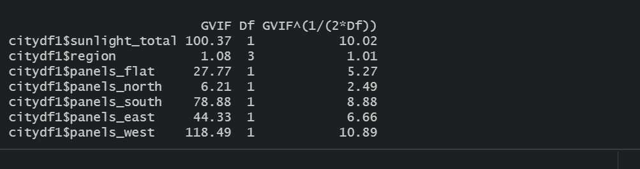
VIF Tests
Since model 4 had linearly dependent variables we remove `panels_total` from the model and we do vif test again.
From the vif test we can observe that only ‘panels_north’ has acceptable vif values, rest of the directional panels have high multicollinearity.

Slide 25
Conclusion

Slide 26
Our Findings
Model 4 is the best:
P-value < 0.05
Multiple R-squared is 95%
Cook’s < 1
The model indicates that:
The more flat, more carbon offset
Adding more solar panels in the South region, help reduce carbon emissions the most
Adding more solar panels in Northeast and West, will actually increase carbon emissions
Installing solar panel facing South and East will help reduce carbon emissions the most
Installing solar panel facing North will actually increase carbon emissions

Slide 27
Caveats
Multicollinearity
High VIF values in early models. Had to adjust models multiple times
Some variables were linearly dependent
High outlier count
Shown in box-plots
Metadata values are all estimates
No real world solar energy panel data

